Slide 1
APRS
Store and Forward
Information
13 April 2021

Slide 2
APRS-Digipeater
Frequency/ baud rate: 145.825 MHz/ 1200 baud
Aliases: APRSAT, ARISS, WIDE
Beacon interval: 45 seconds
Beacon text message:
Satellite | Satellite ID | Message
Tsuru | JG6YMX | hello! this is birdjp
Maya-2 | JG6YMY | hello! this is birdph
GuarniSat | JG6YMZ | hello! this is birdpy
NOTE: Will announce once APRS payload is activated.

Slide 3
APRS-Digipeater
When sending message to satellite APRS payload:
Use satellite ID
Limit message to 50 characters
ACK message should be received

Slide 4
SFward - Store and Forward Mission
SFward aims to demonstrate the ability to collect data/messages from Amateurs via the APRS protocol
To prove the concept, amateur operators and satellite owners may access the satellite via VHF and save their data in a dedicated slot of the mission’s memory. The collected data is downlinked using the UHF link.
SFward follows the message format of APRS protocol.
The collected SFward messages would be published to the BIRDS Project website once downloaded from the satellites.

Slide 5
SFward - Usage Guidance
SFward Microcontroller saves all received APRS packets. Thus it can be used as an amatuer mailing box.
Uplink frequency is 145.825 MHz working only when APRS payload is activated.
Total available data size is 67 characters in each packet. However, the first two bytes are reserved to identify the SFward packets from the rest of the APRS packets.
Packets -which their data part starts with “SF” letters- are considered SFward packets (SF-packets).

Slide 6
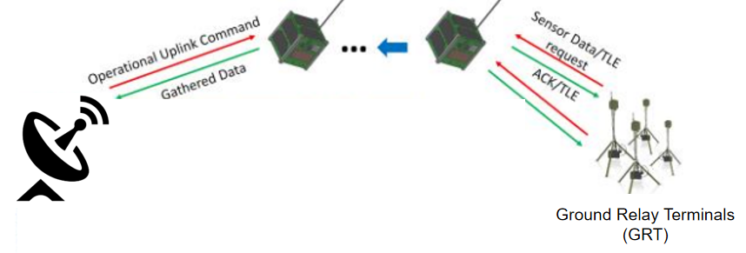
SFward - Concept of Operation
APRS message
Amateur users
ACK
Example message format: SF <insert message up to 65 characters> Destination: JG6YMX/Y/Z (Japan, Philippines, Paraguay)

