Slide 1
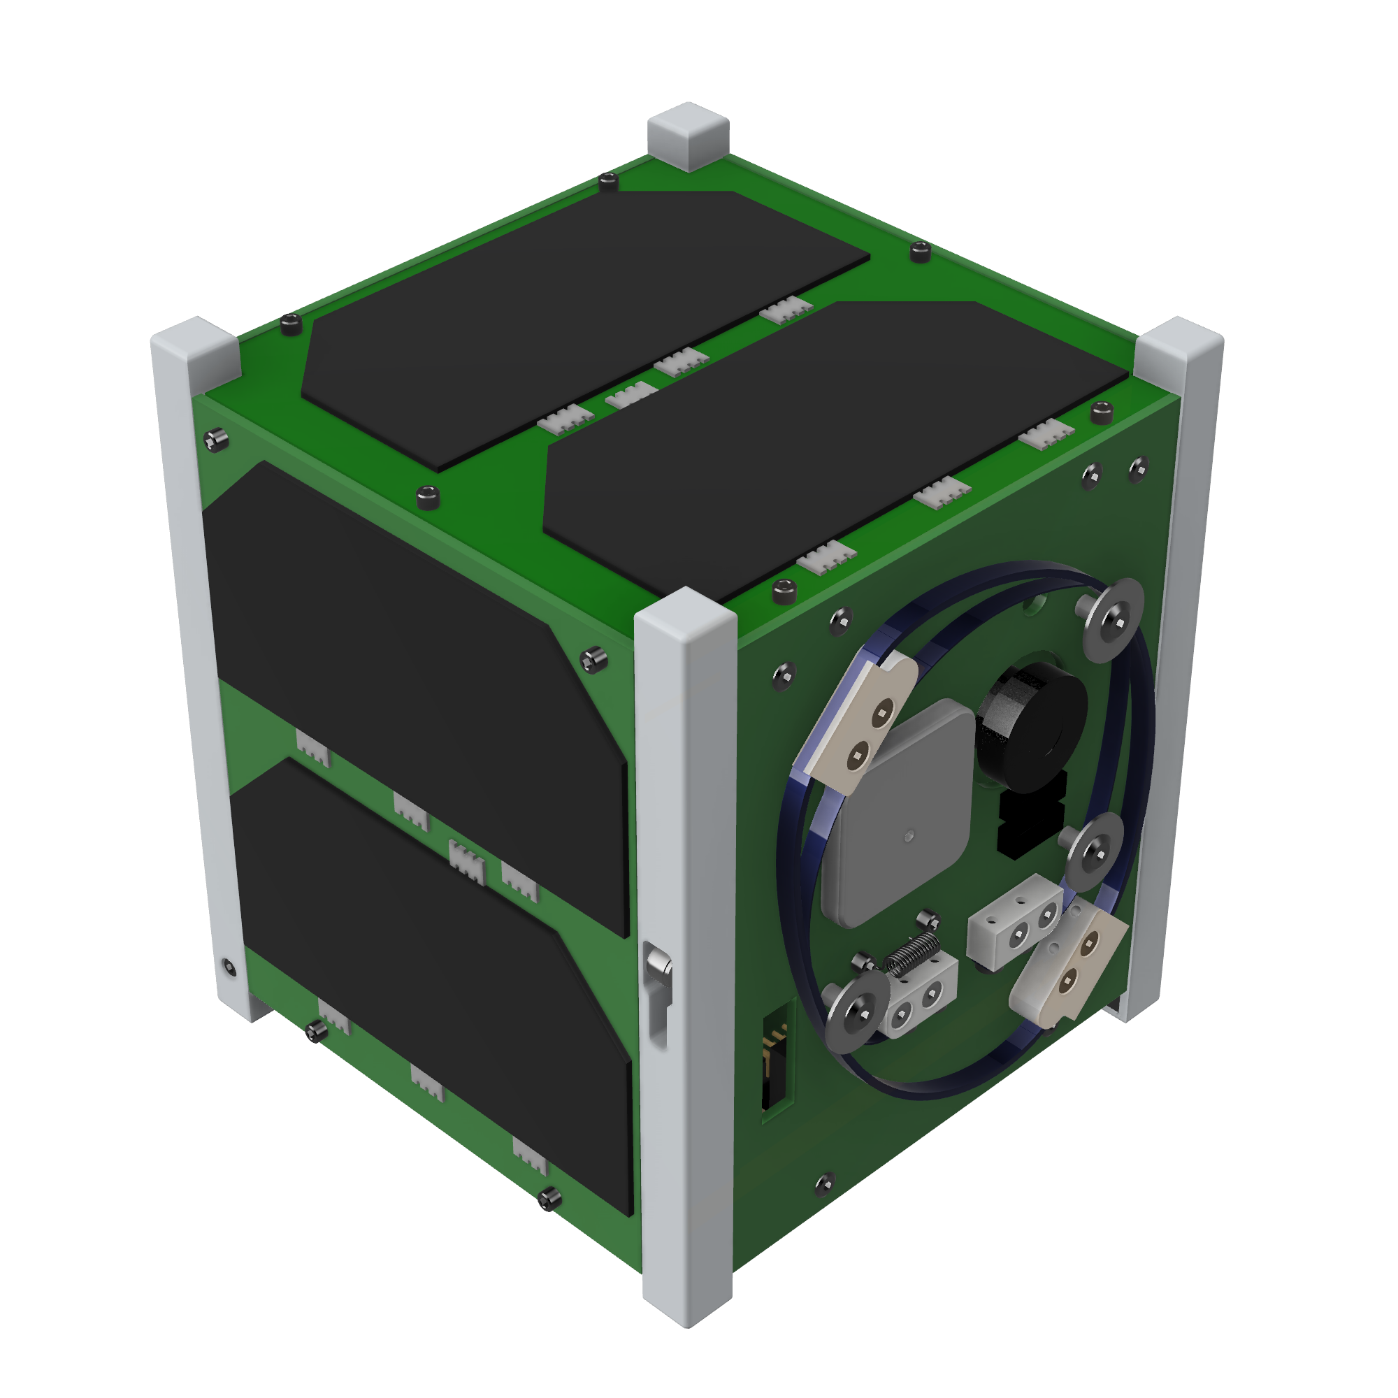
Handover Ceremony & Press Conference
Nakamura Hall ● 11:00 AM
September 24, 2020
Streamed live in
YouTube and Facebook

Slide 2
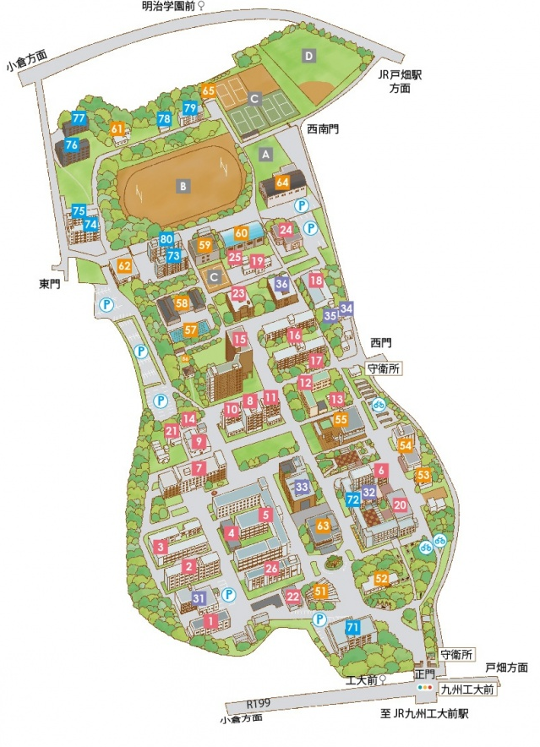
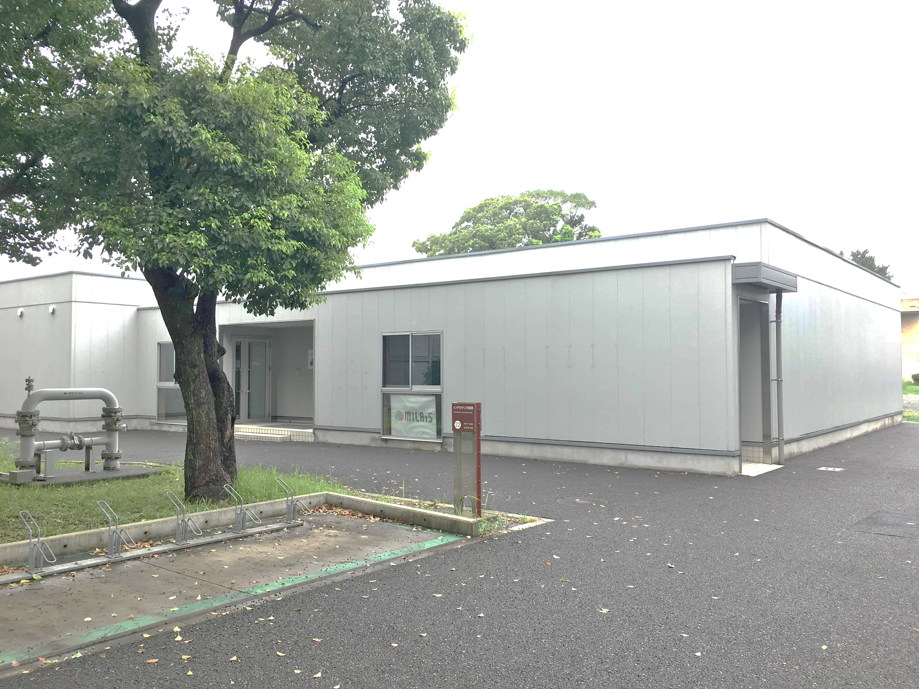
Location Map
CDR Venue: MILAiS
Registrations starts at 12:45 PM

