Slide 1
BIRDS-4 Computer Aided Drawing (CAD)
17 February 2020

Slide 2
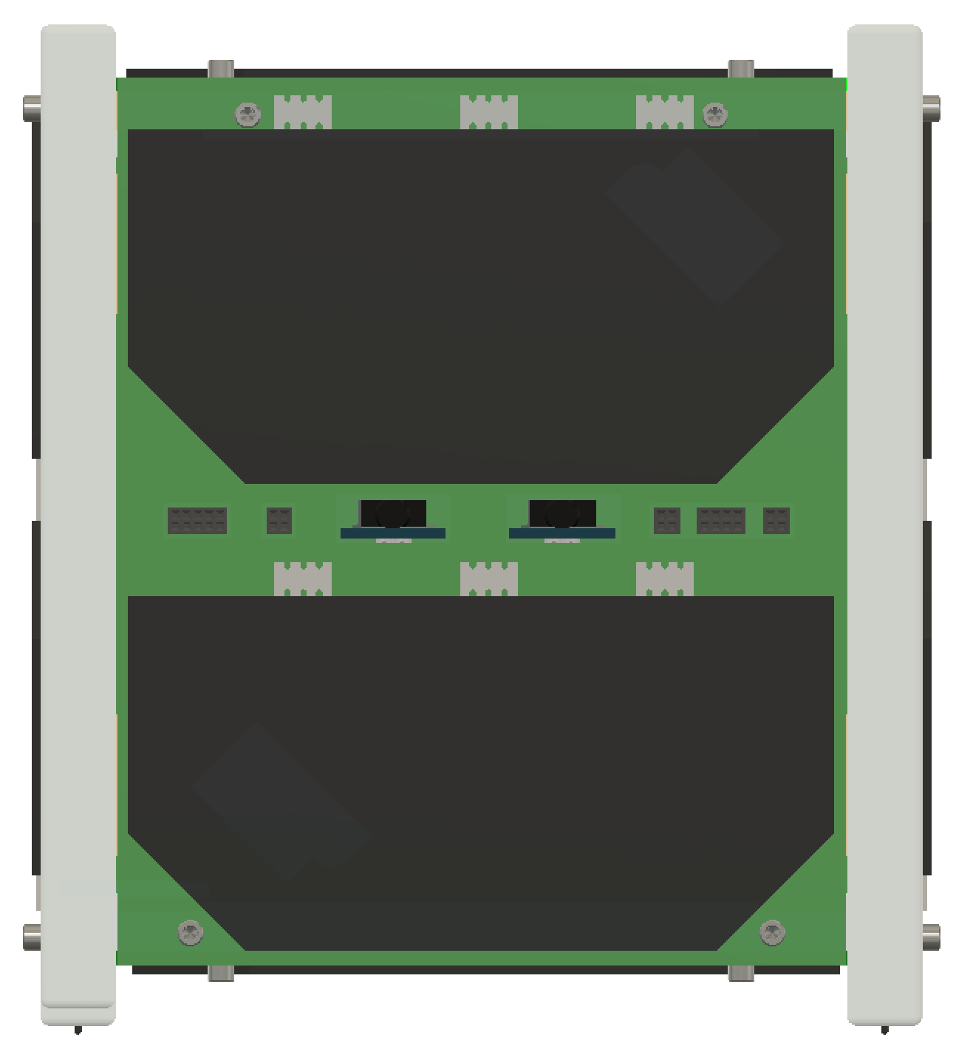
+Y PANEL
100 mm
Z
Solar Panel
Remove Before Flight (RBF) Pins
113.5 mm
111.5 mm
X
Access Port
BIRDS-4 / 17 February 2020

Slide 3
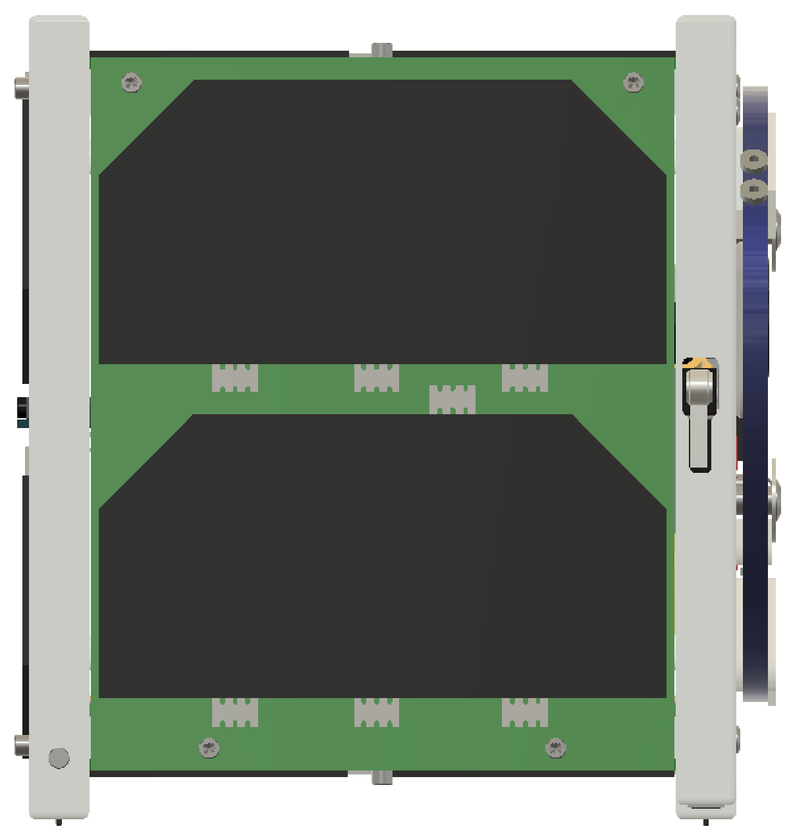
-X PANEL
Z
Solar Panel
Deployment Switch
Y
BIRDS-4 / 17 February 2020

Slide 4
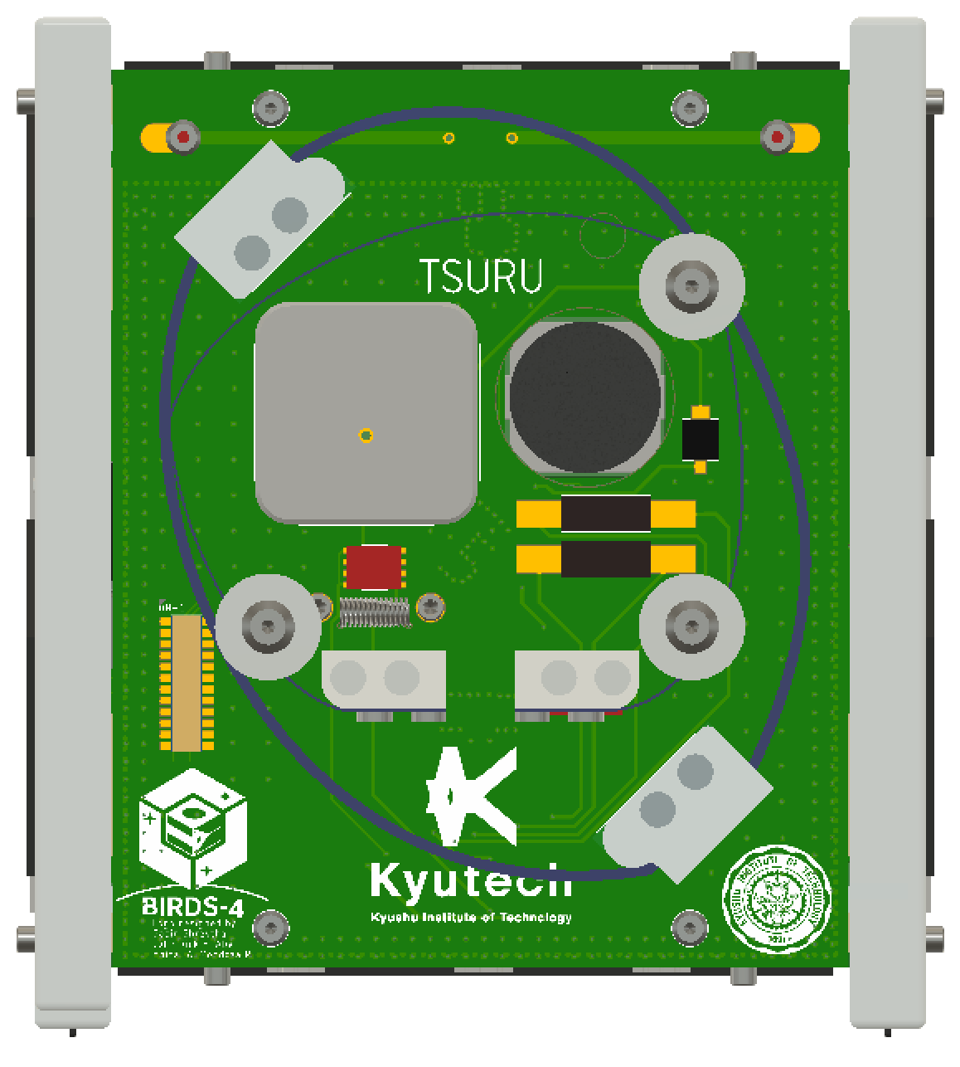
-Y PANEL
Z
Camera
GPS Patch Antenna
Perovskite Solar Cells
X
Deployment Mechanism
BIRDS-4 / 17 February 2020

Slide 5
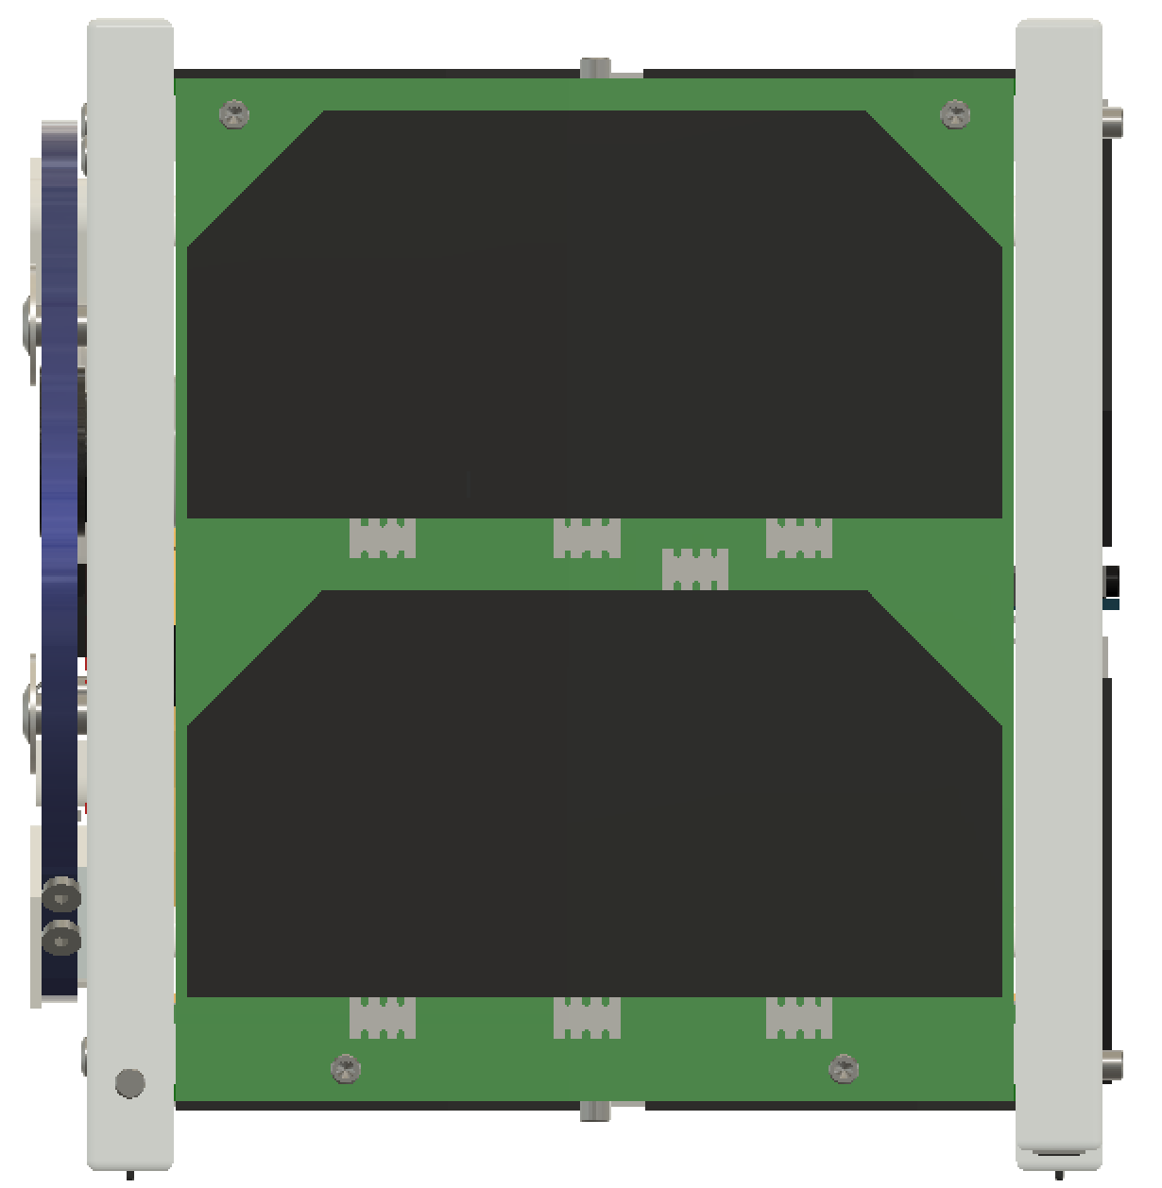
+X PANEL
Z
Solar Panel
Y
BIRDS-4 / 17 February 2020

Slide 6
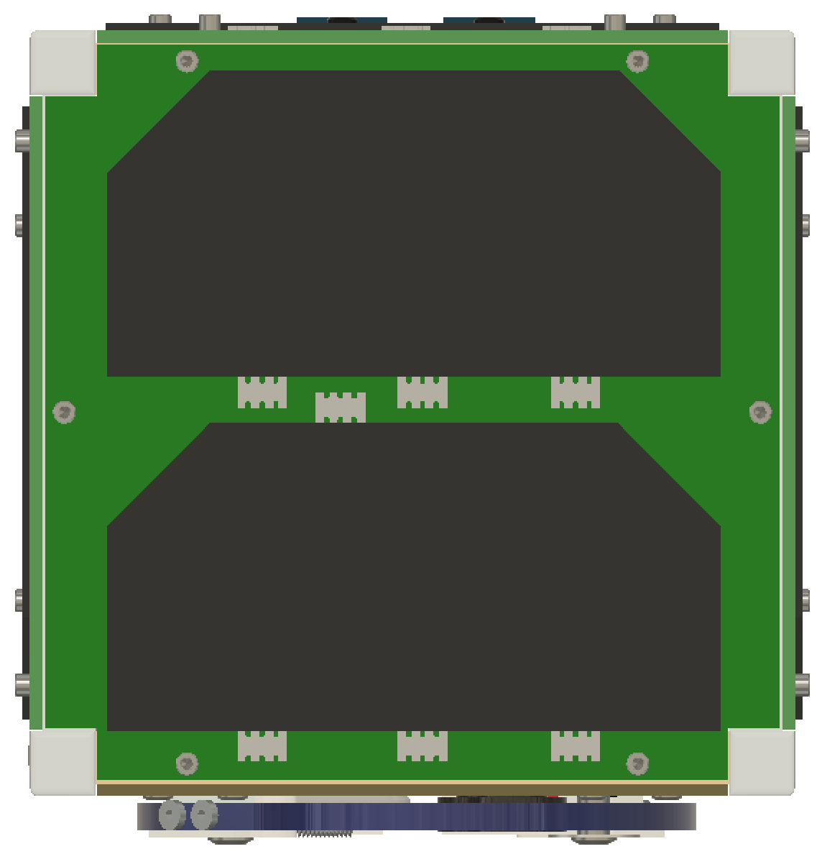
+Z PANEL
Y
Solar Panel
X
BIRDS-4 / 17 February 2020

Slide 7
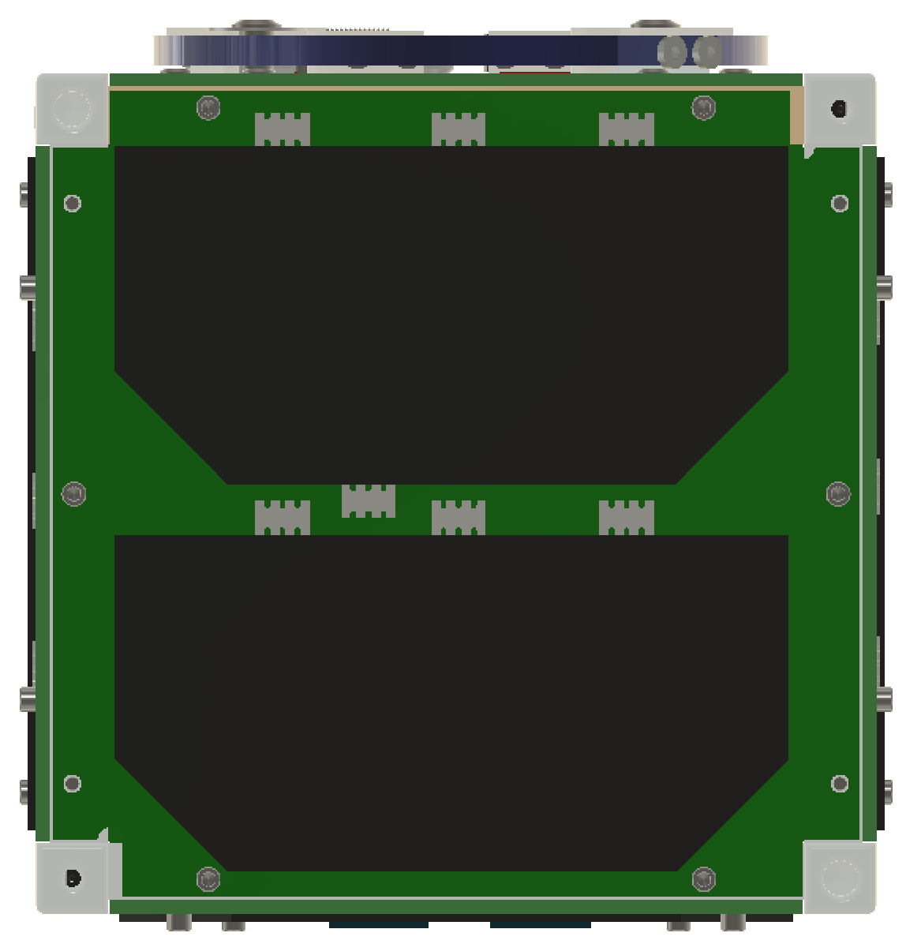
-Z PANEL
Deployment Switch
X
Solar Panel
Y
Separation Spring
BIRDS-4 / 17 February 2020

Slide 8
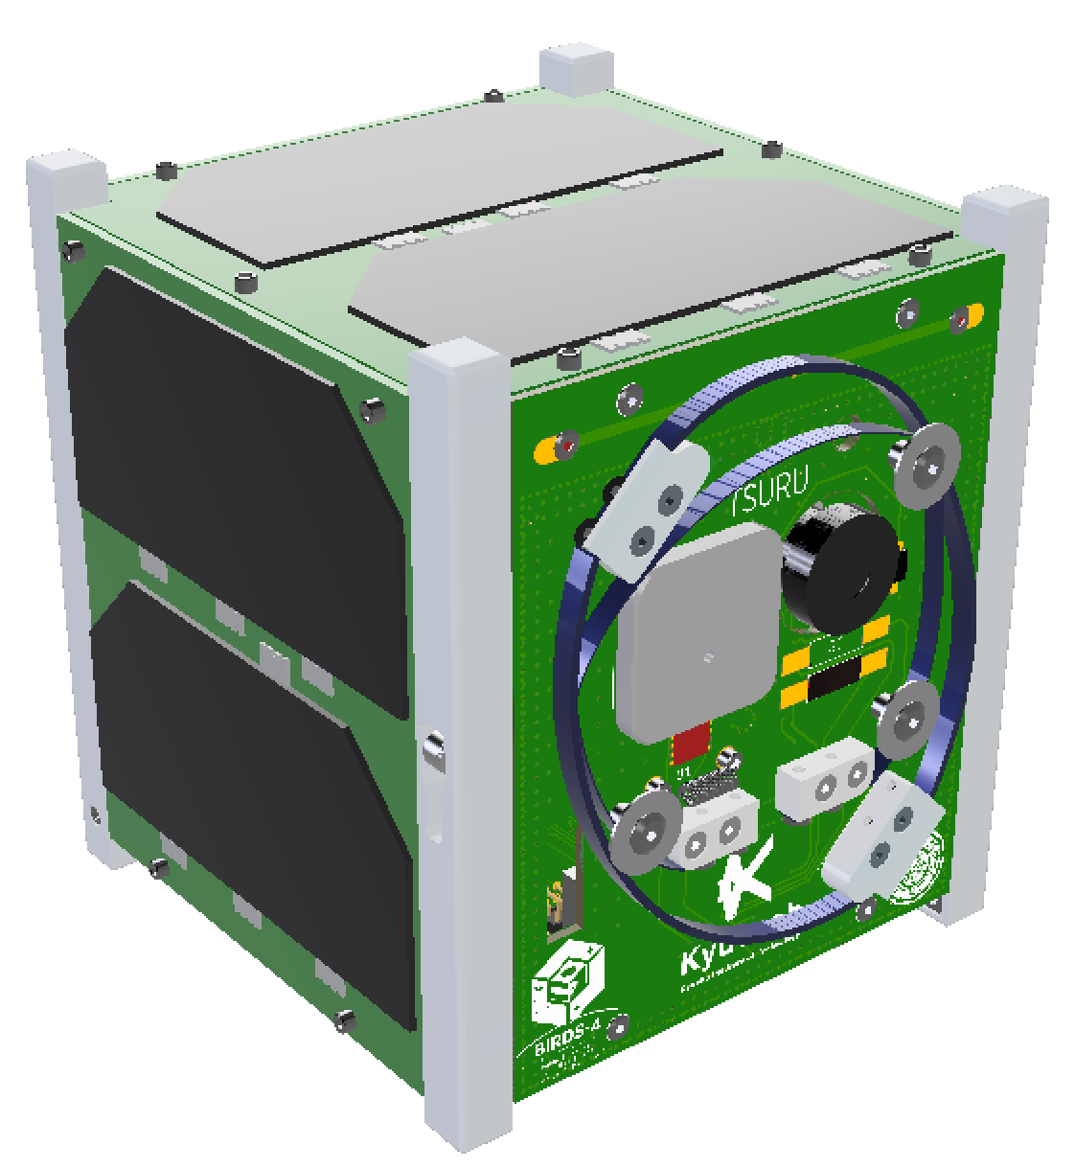
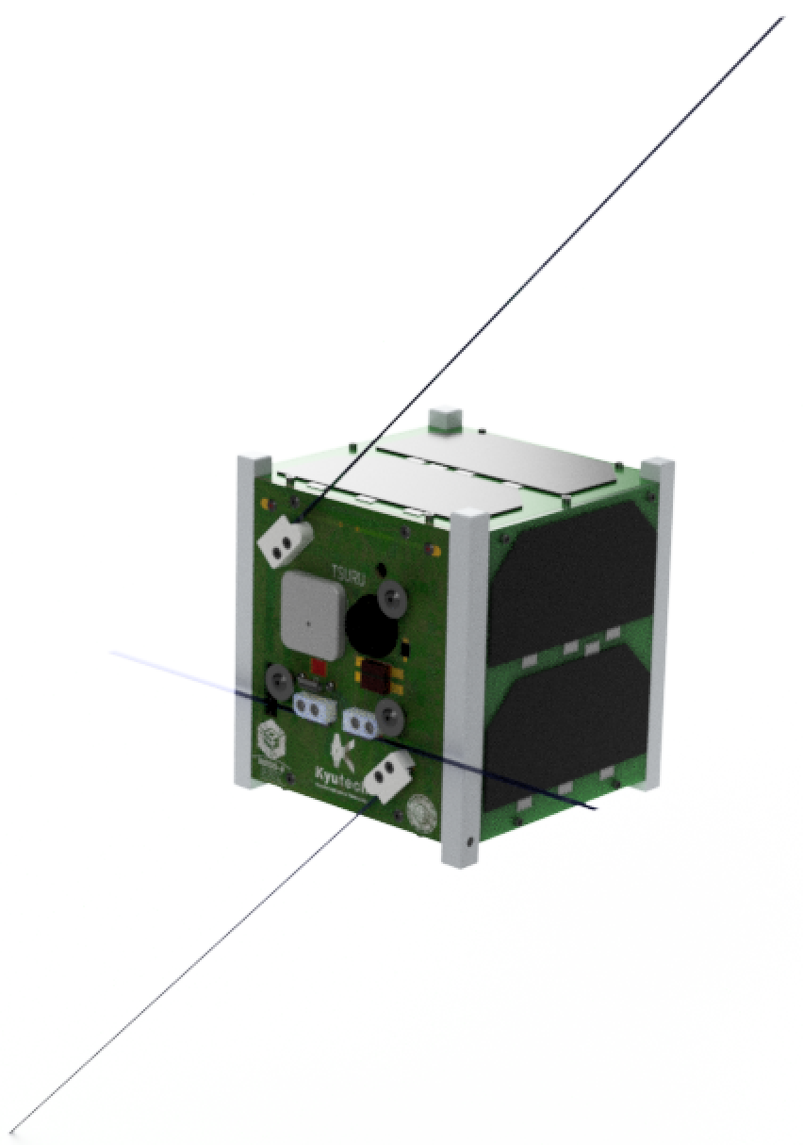
ANTENNA DEPLOYMENT
Z
Y
X
Before Deployment
After Deployment
BIRDS-4 / 17 February 2020

