Slide 1

BIRDS-4’s
Official Logo
Mark Angelo C. Purio
January 15, 2019

Slide 2
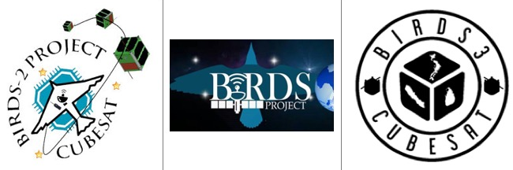
BIRDS-4 Official Logo
Written By: Mark Angelo Purio
In terms of public visibility and distinction, having a logo is an integral part of an organization or a project . A logo, in general, is the face of the project. More than just an image, it conveys the project’s goals and embodies the entire project in one clear representation.
BIRDS Project has the tradition of giving each umbrella projects a distinction through its own logo. As shown in the figure, such logos have evolved and have changed from one project to another.
Since BIRDS-4 project begun last October 2019, the members decided to have the logo to better represent the team. In order to come up with a better design, a logo-making contest was launched. Logos were solicited from participating countries through online submission.
Previous BIRDS Satellite Project logos. BIRDS-2 (Left), BIRDS-1 (Mid), and BIRDS-3 (Right)
Ten (10) entries from Japan, Paraguay, Philippines and Nepal were received during the online submission. The BIRDS-4 team members and Prof. Cho chose the winning logo among the submitted entries.
To better represent the BIRDS-4 project, the team also gave input by revising the chosen logo according to the message that it wants to convey to its stakeholders and to the community. As such, the final logo provides meaning through the different marks it possesses.

Slide 3
BIRDS-4 Official Logo
Written By: Mark Angelo Purio
The BIRDS-4 team members would like to express their deep appreciation to everyone who submitted their entries and helped us come up with a logo design that fits the project. Also, thank you Alex Sobieski for rendering the final logo.
You are all part of this milestone by the design which embodies the mission of the project and which represents our team accurately. Now that BIRDS-4 Satellite Project has its logo, winners will be contacted through e-mail and they get to have their names being written on the BIRDS-4 CubeSat.
BIRDS-4 Satellite Project Logo Entries

Slide 4
BIRDS-4 Official Logo
Written By: Mark Angelo Purio
Logo’s Meaning
Orthogonal Cube Shape
Gives an impression of a cube in an orthogonal perspective which embodies the CubeSat (Cube Satellite) that the team will be designing, building and deploying to space.
Curve Line at the Bottom
This line denotes the earth’s horizon as seen from space. Its presence suggests that despite of the satellite being away from our home planet, it will still communicate to earth wirelessly providing important data from its missions.
Country Flags in the Middle
The flags represent the participating countries for this satellite project: Japan, Paraguay and Philippines. It is arranged to form an orthogonal cube shape as well, taking into consideration their respective geographical locations in the map. Moreover, the connection between the flags symbolizes being one in this endeavor and foster solidarity while building the satellite
3 Stars with 4 Points
The three (3) stars represents the three satellites to be built for each of the countries while the star in itself represents the satellite being in space. In addition the intentional use of 4-pointed star denotes that this project is fourth of its kind.
BIRDS-4 Satellite Project official logo

Slide 5
BIRDS-4 Official Logo
Written By: Mark Angelo Purio
Logo’s Meaning
Three (3) L-Shaped Chevrons
Being true to its primary mission, these chevrons, aside from forming the hexagonal shape, signifies three letter L’s which is an abbreviation of 3 words: Lean, Learn and Lead.
Lean
As an interesting and challenging way to build a satellite, the lean satellite concept emphasizes on building high quality satellites with minimum cost and shortest time possible. Applying such concept, the team is working together to achieve this while focusing on its goals.
Learn
Building the satellite involves learning every aspect of it from technical to managerial work. The team members will acquire the needed skills and aptitude needed to build their own satellite when they return to their home countries.
Lead
As future leaders in terms of space technology for their respective countries, BIRDS-4 team members will be honed to imbibe the team spirit and leadership skills and be frontrunners as advocates of space science and technology to their home countries.
BIRDS-4 Satellite Project official logo

