Slide 1
BIRDS-4 Computer Aided Drawing (CAD)
28 March 2019

Slide 2
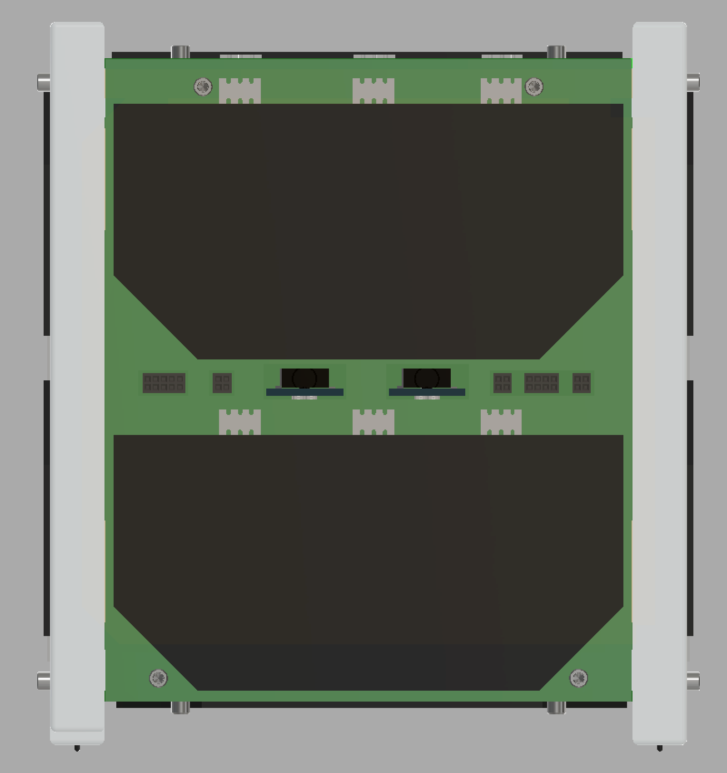
+X PANEL
Z
Solar Panel
Put Before Flight (PBF) Pins
Y
Access Port
BIRDS-4 / 28 March 2019

Slide 3
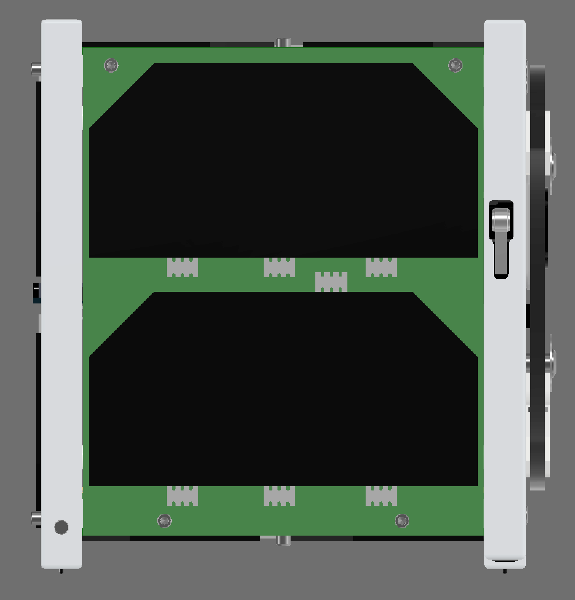
+Y PANEL
Z
Solar Panel
Deployment Switch
X
BIRDS-4 / 28 March 2019

Slide 4
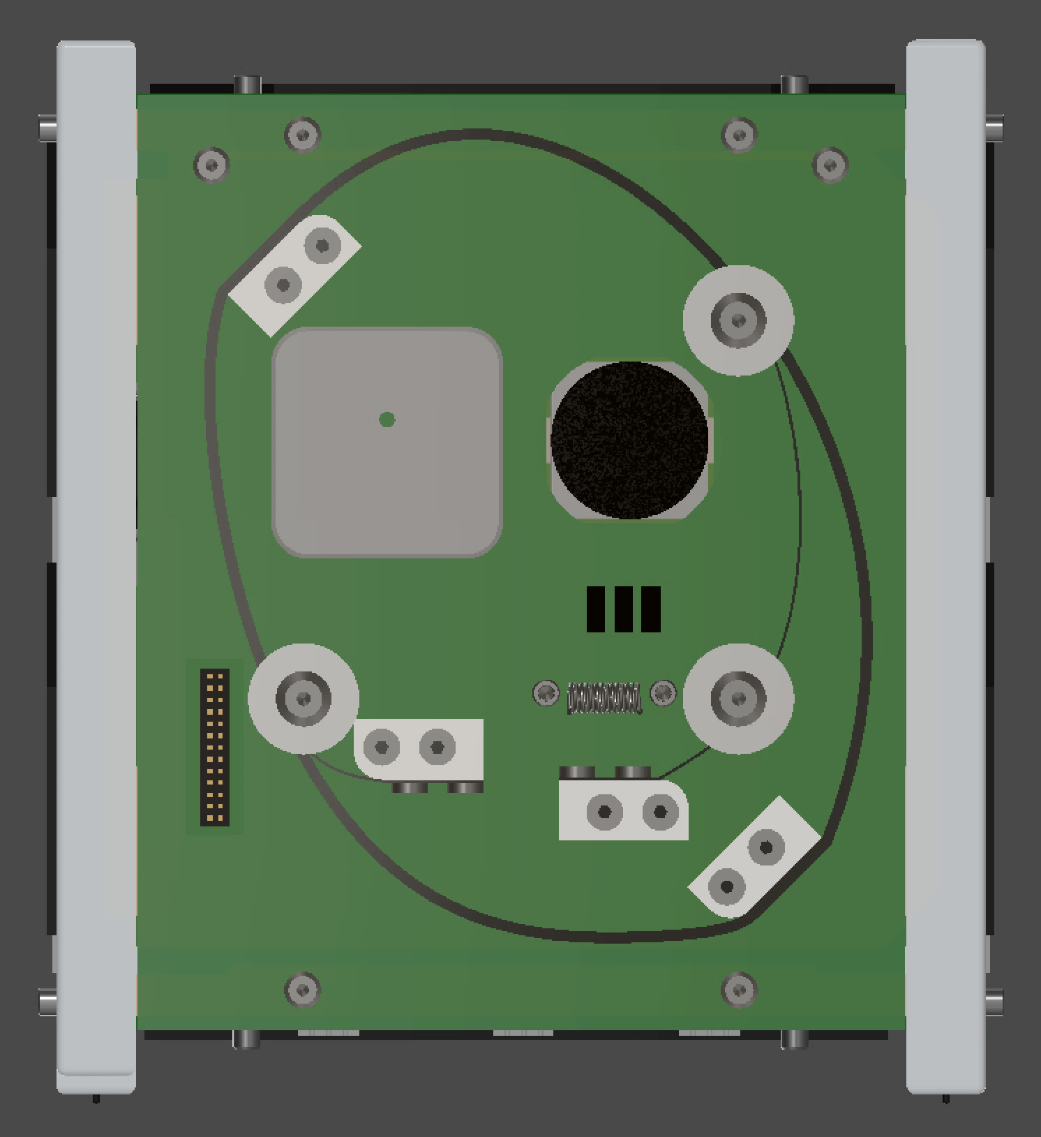
-X PANEL
Z
Camera
GPS Patch Antenna
Perovskite Solar Cells
Y
Deployment Mechanism
BIRDS-4 / 28 March 2019

Slide 5
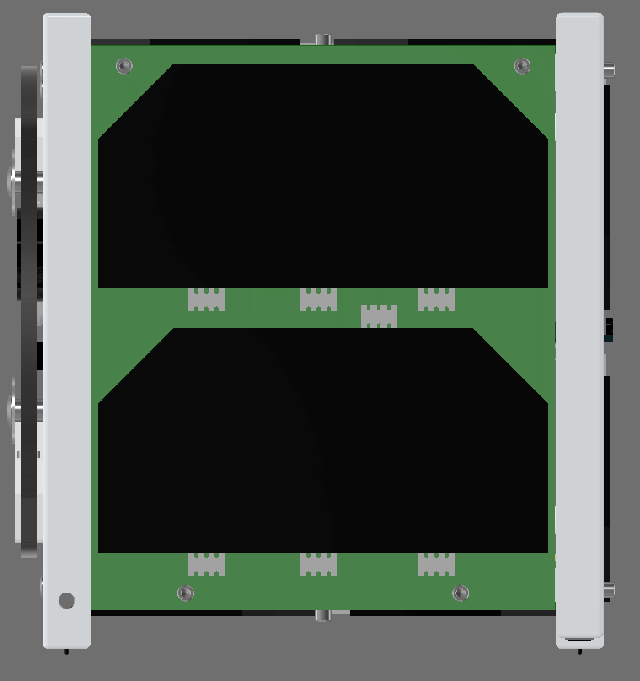
-Y PANEL
Z
Solar Panel
X
BIRDS-4 / 28 March 2019

Slide 6
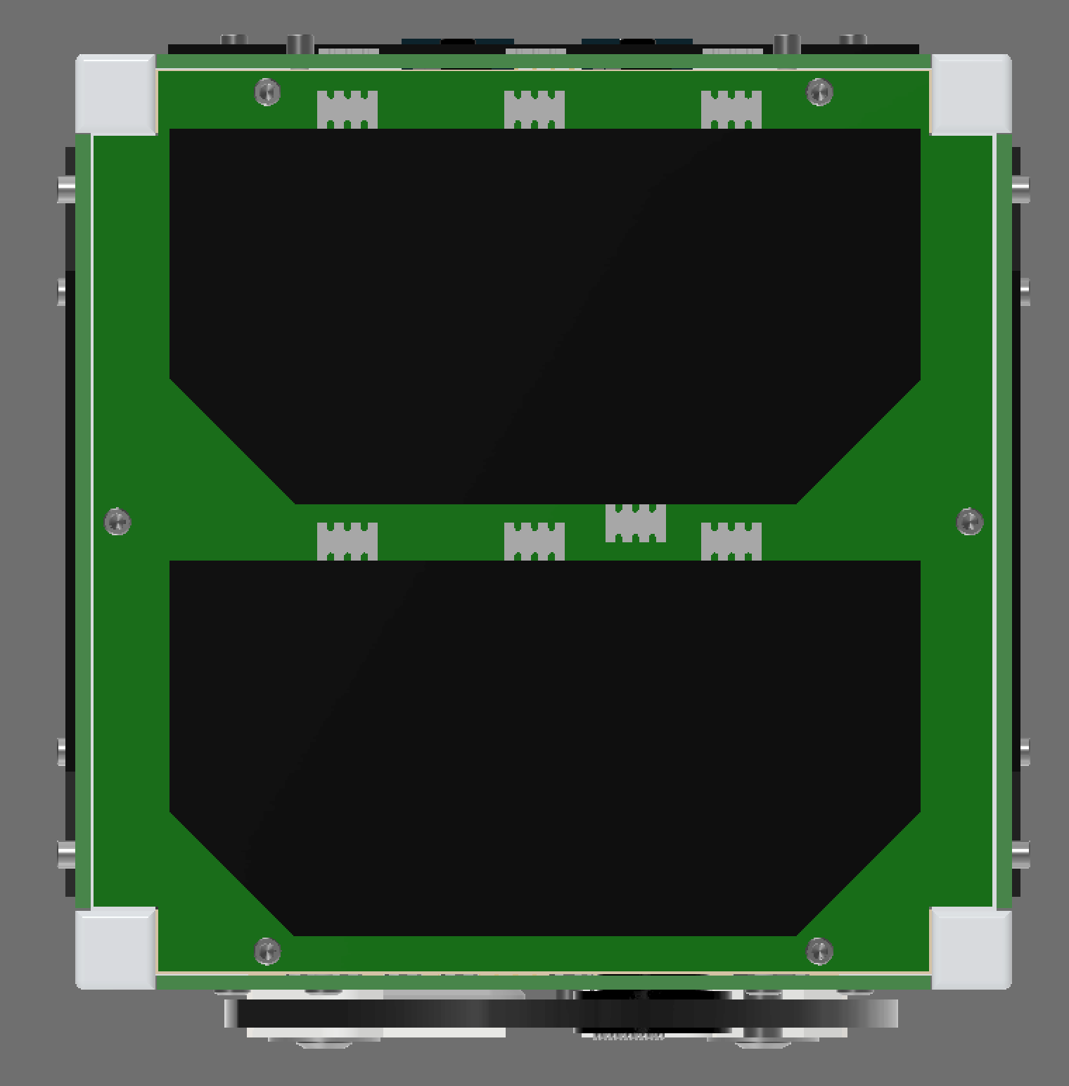
+Z PANEL
Y
Solar Panel
X
BIRDS-4 / 28 March 2019

Slide 7
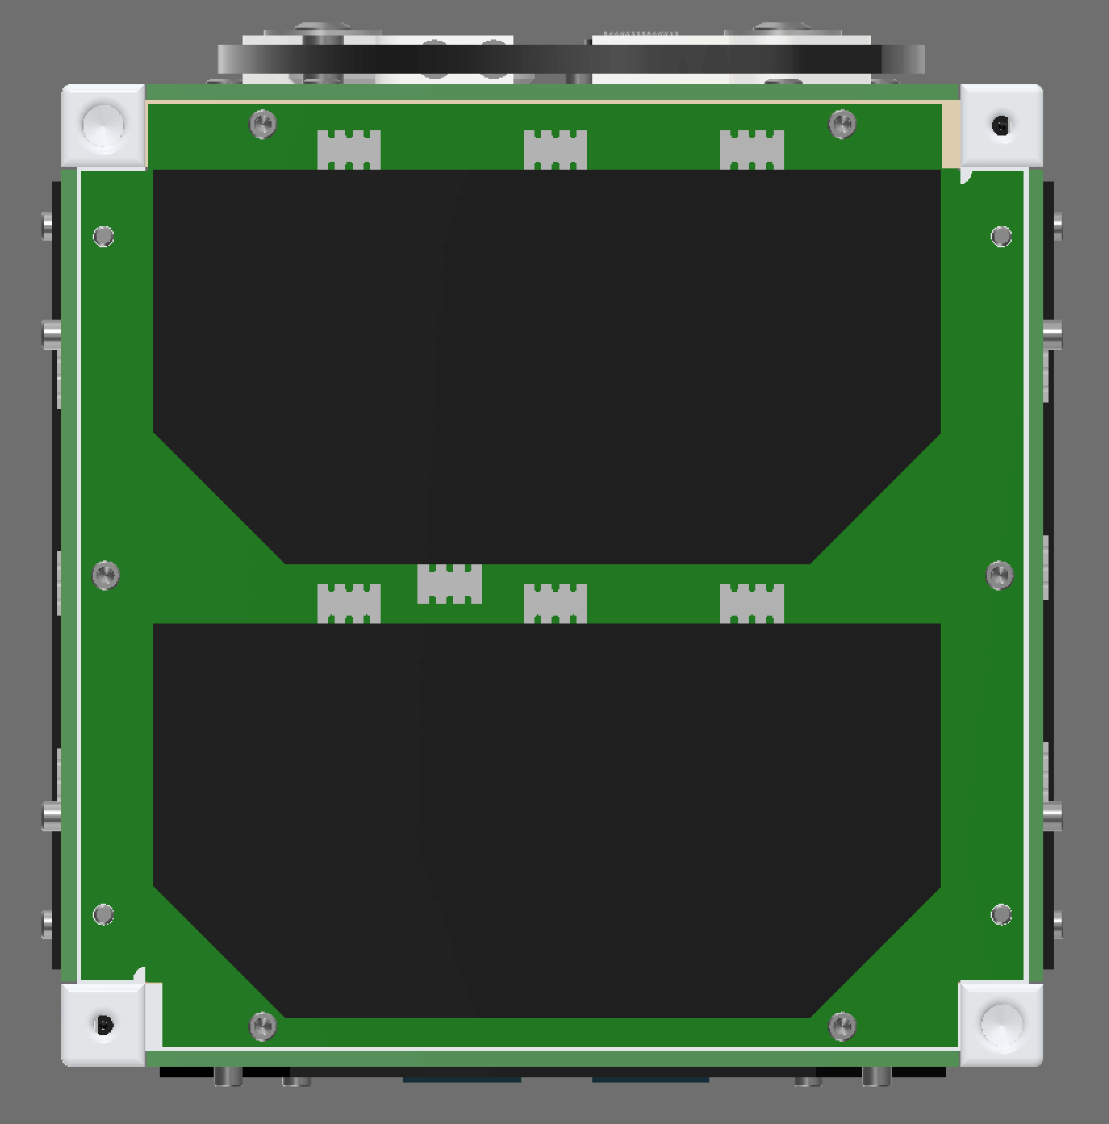
-Z PANEL
Deployment Switch
Y
Solar Panel
Separation Spring
X
BIRDS-4 / 28 March 2019

Slide 8
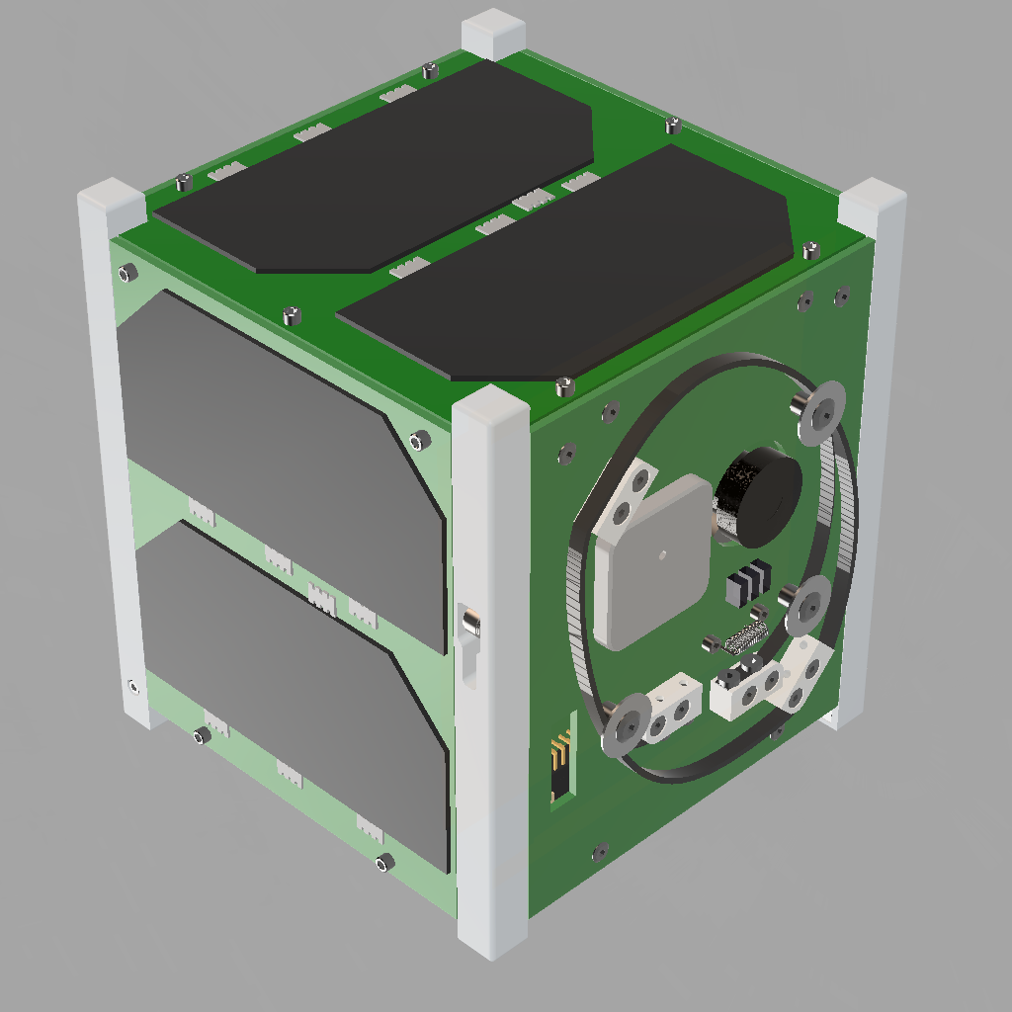
ANTENNA DEPLOYMENT
Z
X
Y
Before Deployment
After Deployment
BIRDS-4 / 28 March 2019

